Slide 1
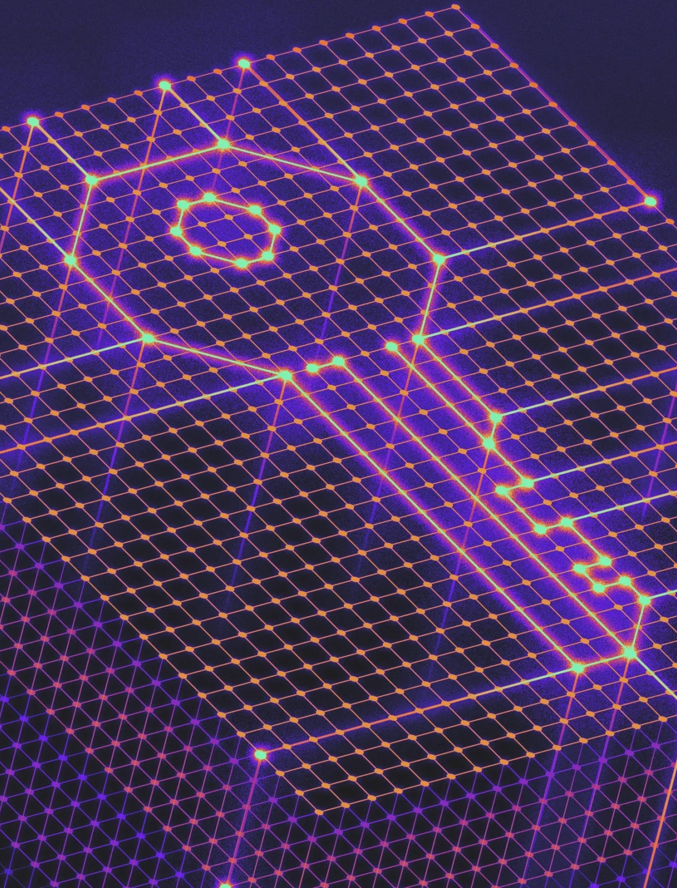
Cryptography

Slide 2
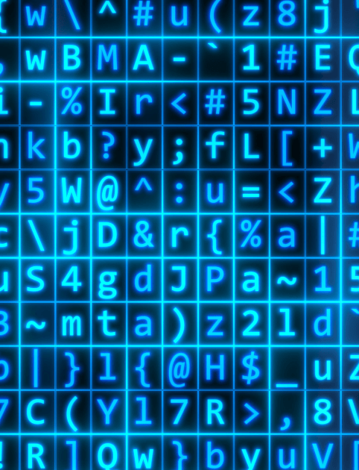
What is Cryptography?
The ‘art’ of secret communication.
Not all information is intended for everyone, how do we make sure only those who should see it can?

Slide 3
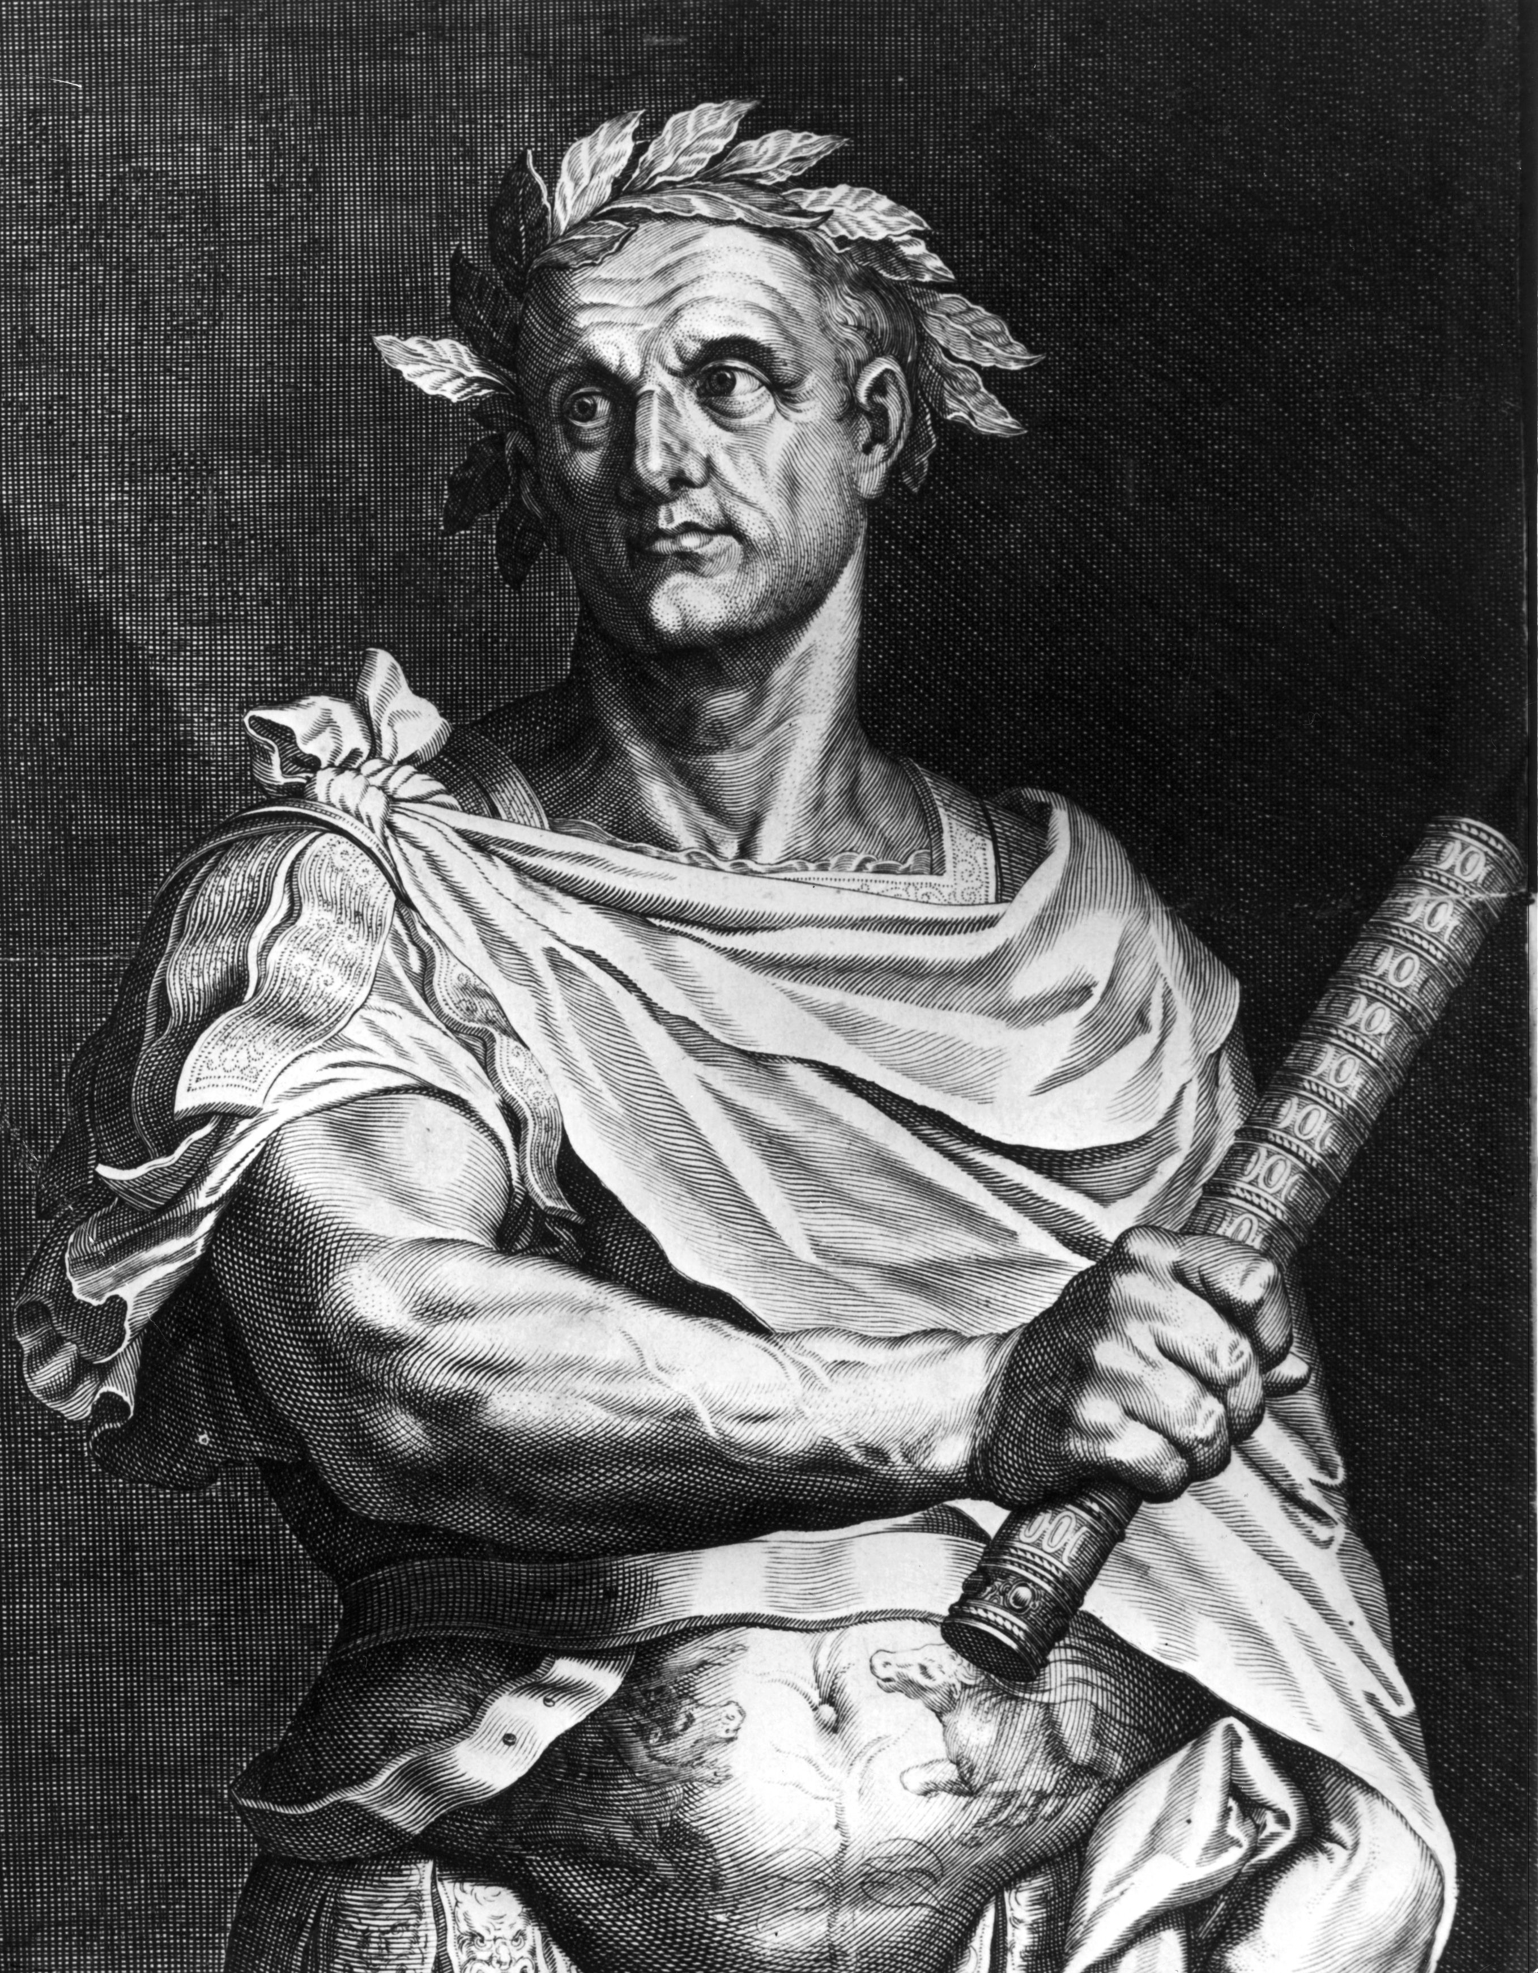
Ancient Cryptography
Caesar and the Romans used shift ciphers for communicating the movements of the Roman legions.
A simple, but effective, method.

Slide 4
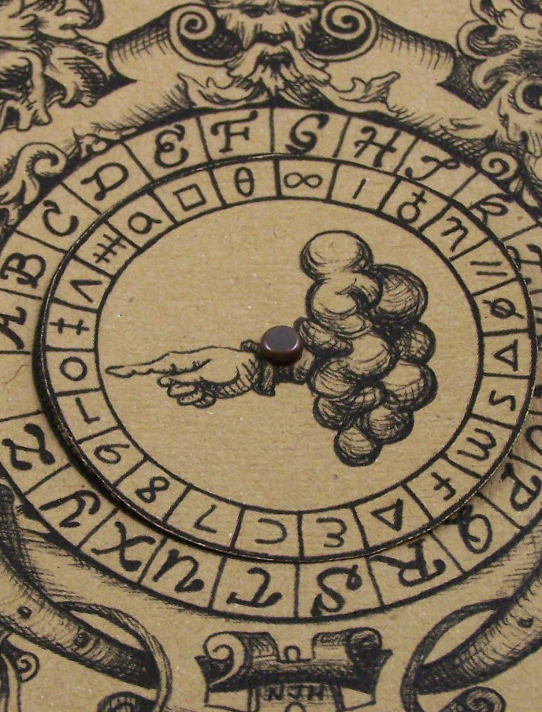
Renaissance Secrets
More sophisticated cipher systems invented that are harder to break.
The Vigenère cipher was not frequently broken until the 19th century.

Slide 5
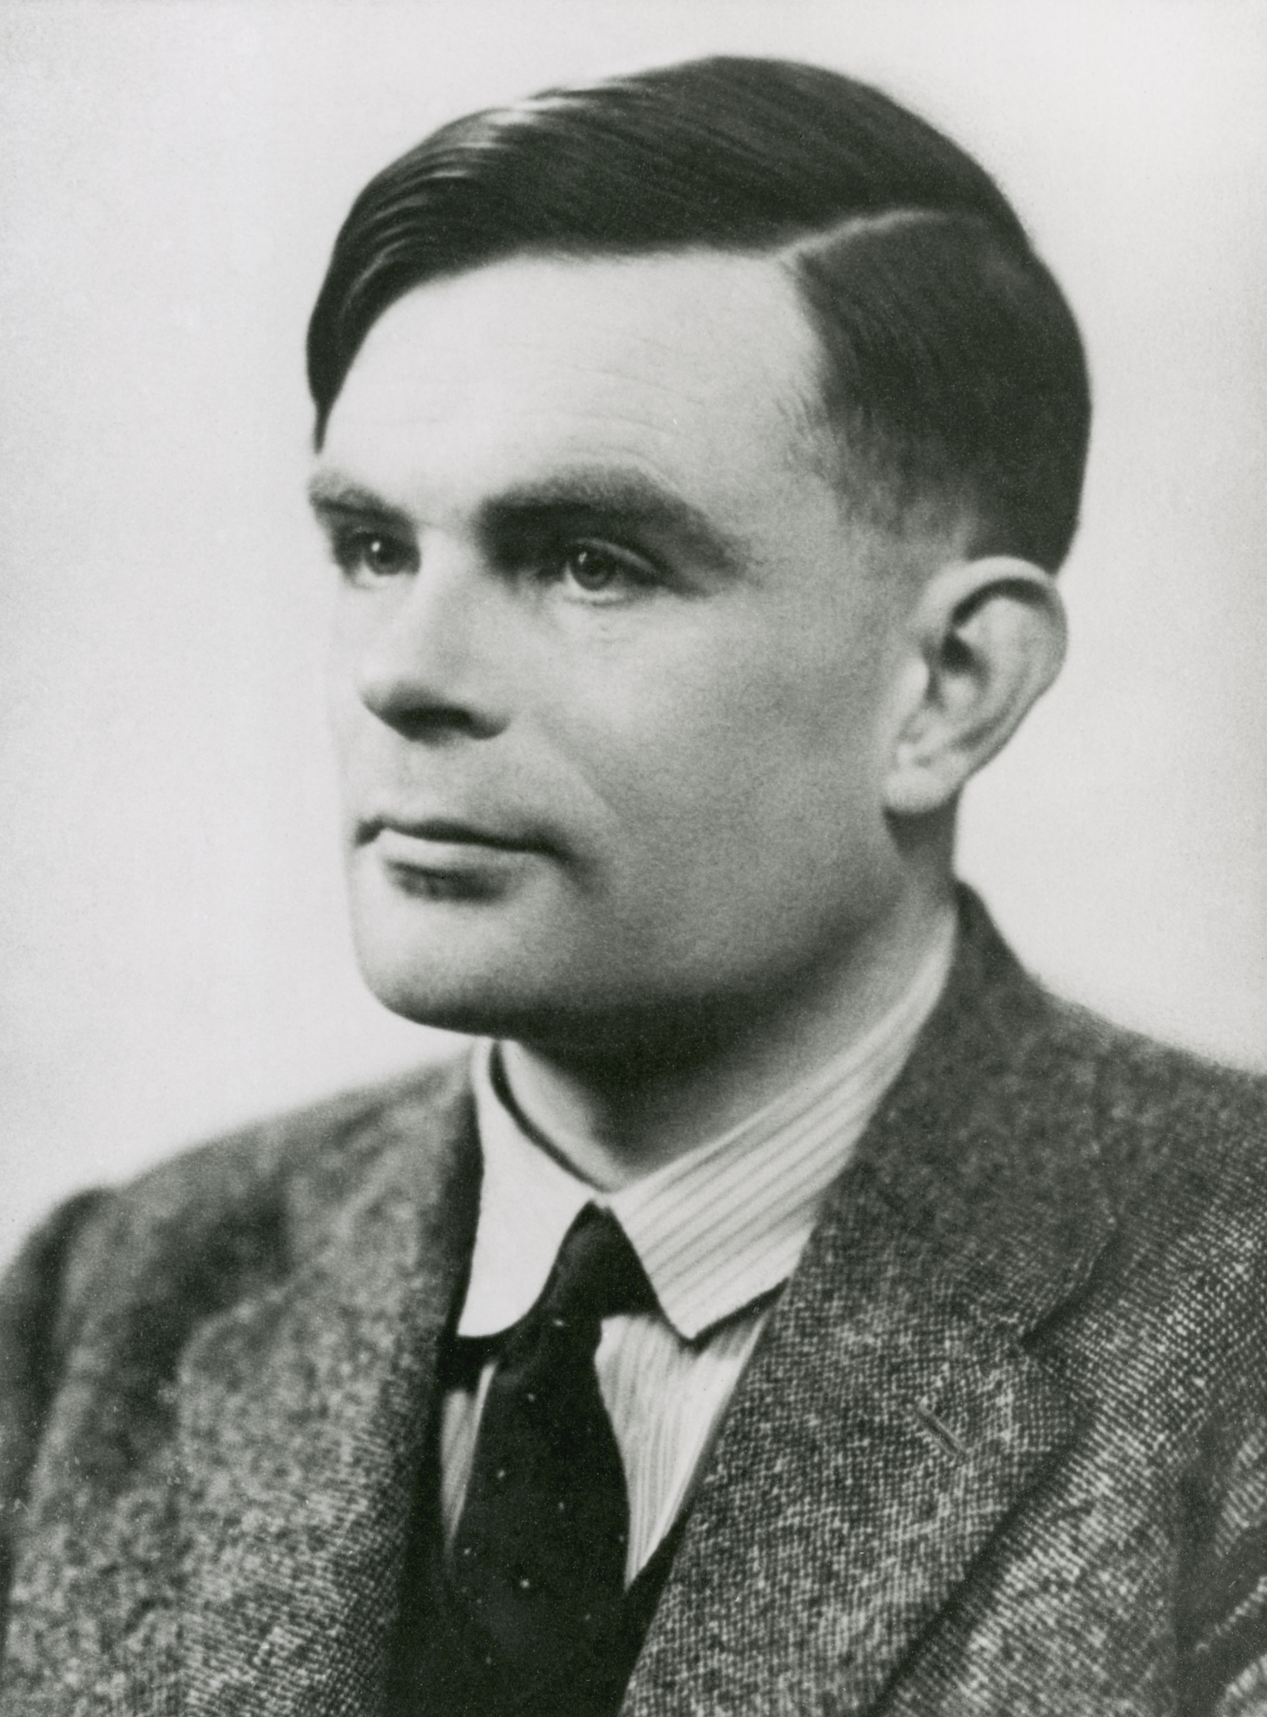
War Time Code-Breaking
The Enigma and Lorenz ciphers were the most complicated cryptographic systems to date.
Necessitated a new field of study to break them: computer science.

Slide 6
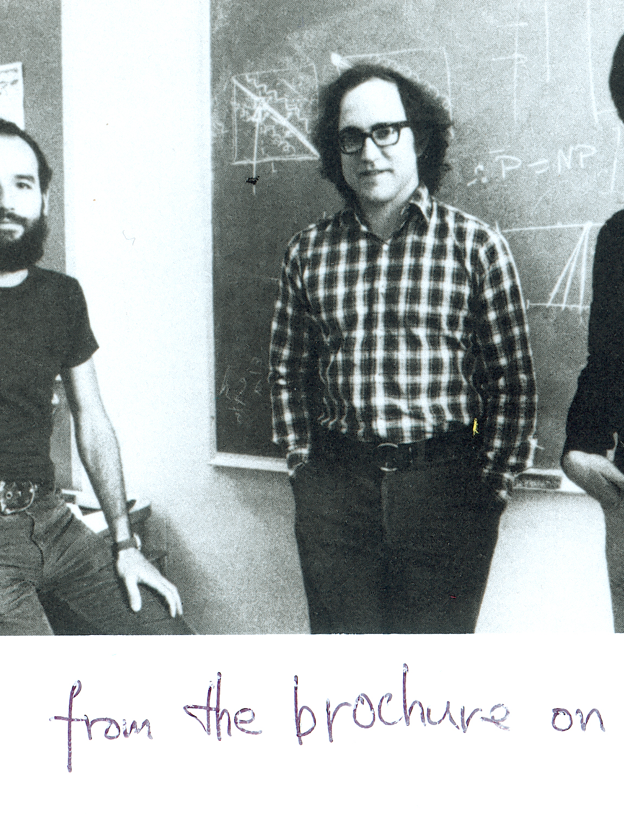
Digital Cryptography
With the advent of large scale digital computing came the need for updated cryptosystems.
RSA and Diffie-Hellmann started this movement in the 1970s.

Slide 7
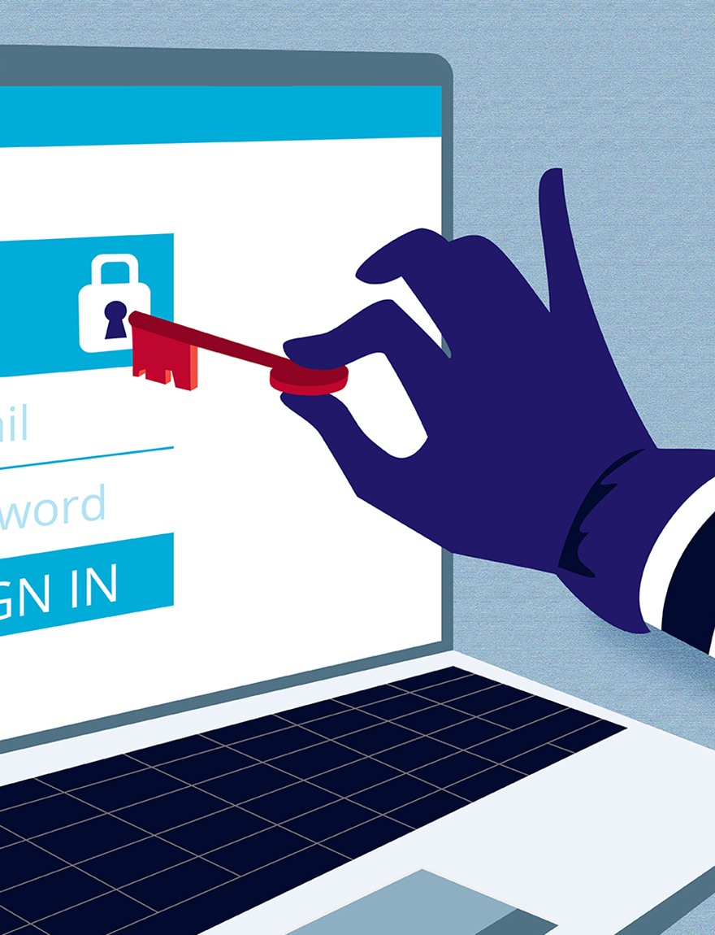
Foundational for a World Online
Almost all online systems use some kind of cryptographic protocol.
From internet banking, to simple message services, all of us are using these systems every day.

Slide 8
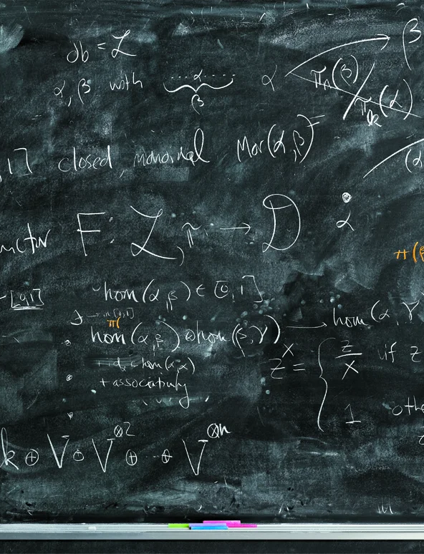
What Makes Cryptography Tick?
Relies on ‘hard’ maths problems that can’t be easily broken.
The answer to the problem will often be the key to decryption.

Slide 9
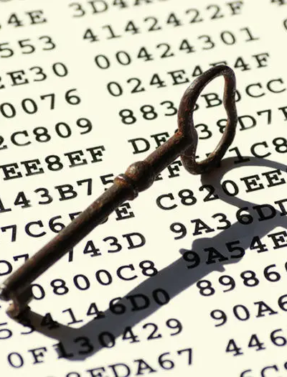
Symmetric vs. Asymmetric Cryptography
Symmetric encryption relies on both parties having the same secret information
Asymmetric encryption allows two parties to talk without sharing a secret first

Slide 10

Cryptographic Primitives
Encrypted messaging
Key Encapsulation
Authentication (MACs)
Digital Signatures
Proving who you are (Identity protocols)

Slide 11
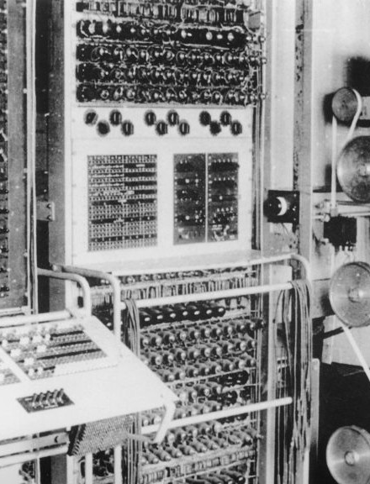
Cryptanalysis and Code Breaking
Cryptanalysis (the study of breaking cryptography) is as important as cryptography.
Necessary to understand exactly how secure the cryptosystems are.

Slide 12

Today
Symmetric cryptography:
Caesar Ciphers
Monoalphabetic Ciphers
Vigenère Ciphers
Asymmetric cryptography:
RSA
Cryptography game
Post-Quantum Cryptography

Slide 13
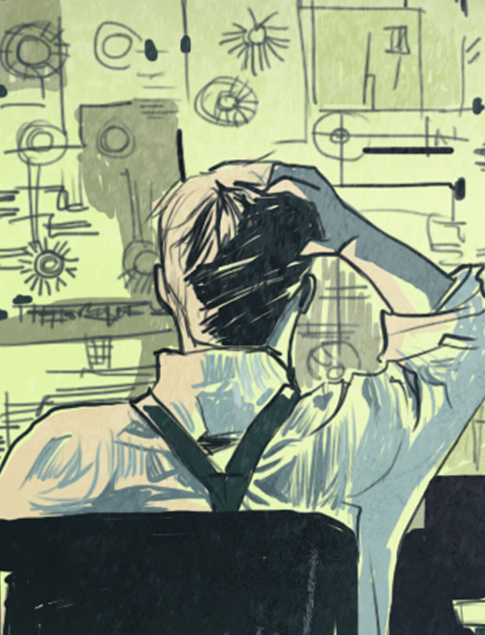
Questions?

